Slide 1
Database System (CS-103)
Data Modeling Using the Entity-Relationship (ER) Model
Mr. Hamza Javed,
Department of Computer Science,
Muslim Youth University, Islamabad, Pakistan

Slide 2
Tools
Tools : There are a number of software that can work with the ER-Diagram, such as:
Microsoft Visio
Draw.io
ERDPlus
Dbdiagram
Lucidchart
It's up to you to decide but recommend to use Draw.io

Slide 3
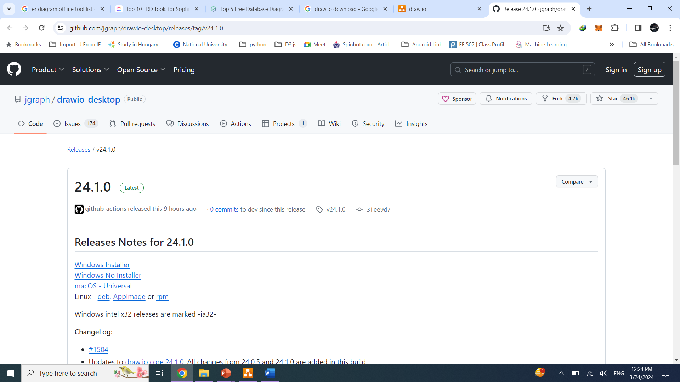
Draw.io Downloading & Installation Steps
Download link: https://dev.mysql.com/downloads/installer/
Download Video link:
https://classroom.google.com/c/NjU1ODEyMzcxODMz/m/NjY5MzU3NTI3OTc0/details
Installation Video link:
https://classroom.google.com/c/NjU1ODEyMzcxODMz/m/NjU1OTcyNDY3OTE1/details

Slide 4
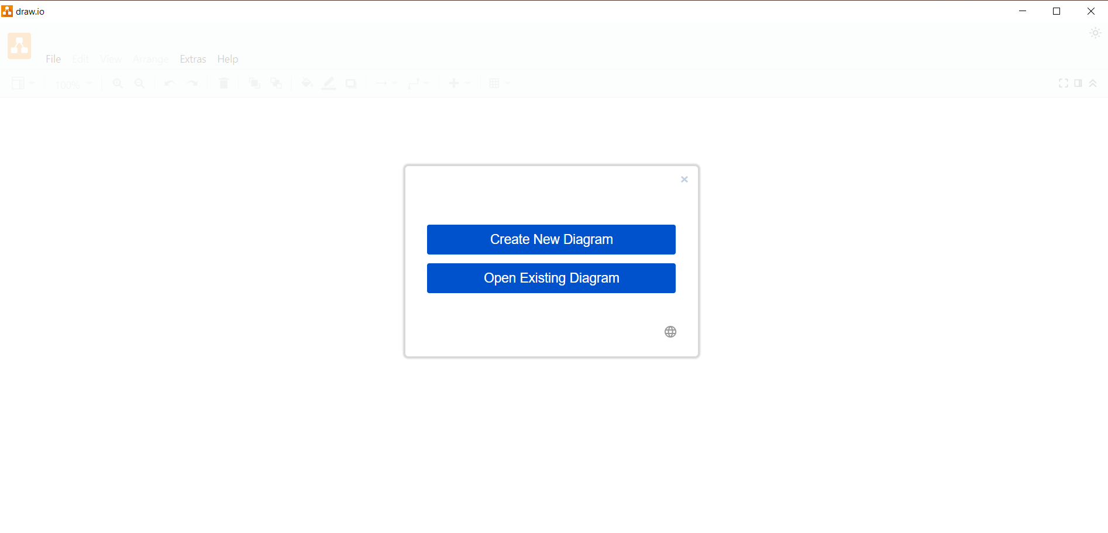
Creating New Diagram

Slide 5
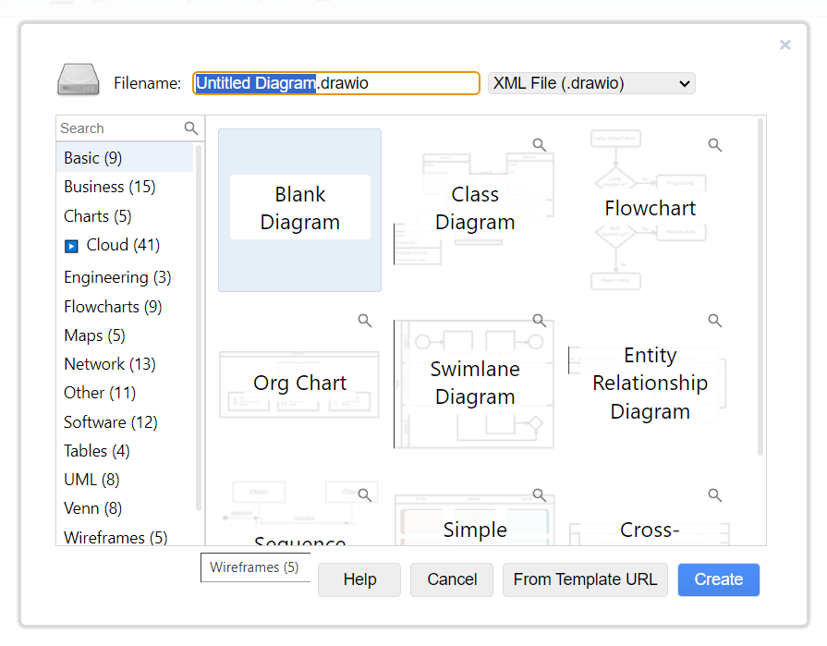
Select New Blank Diagram

Slide 6
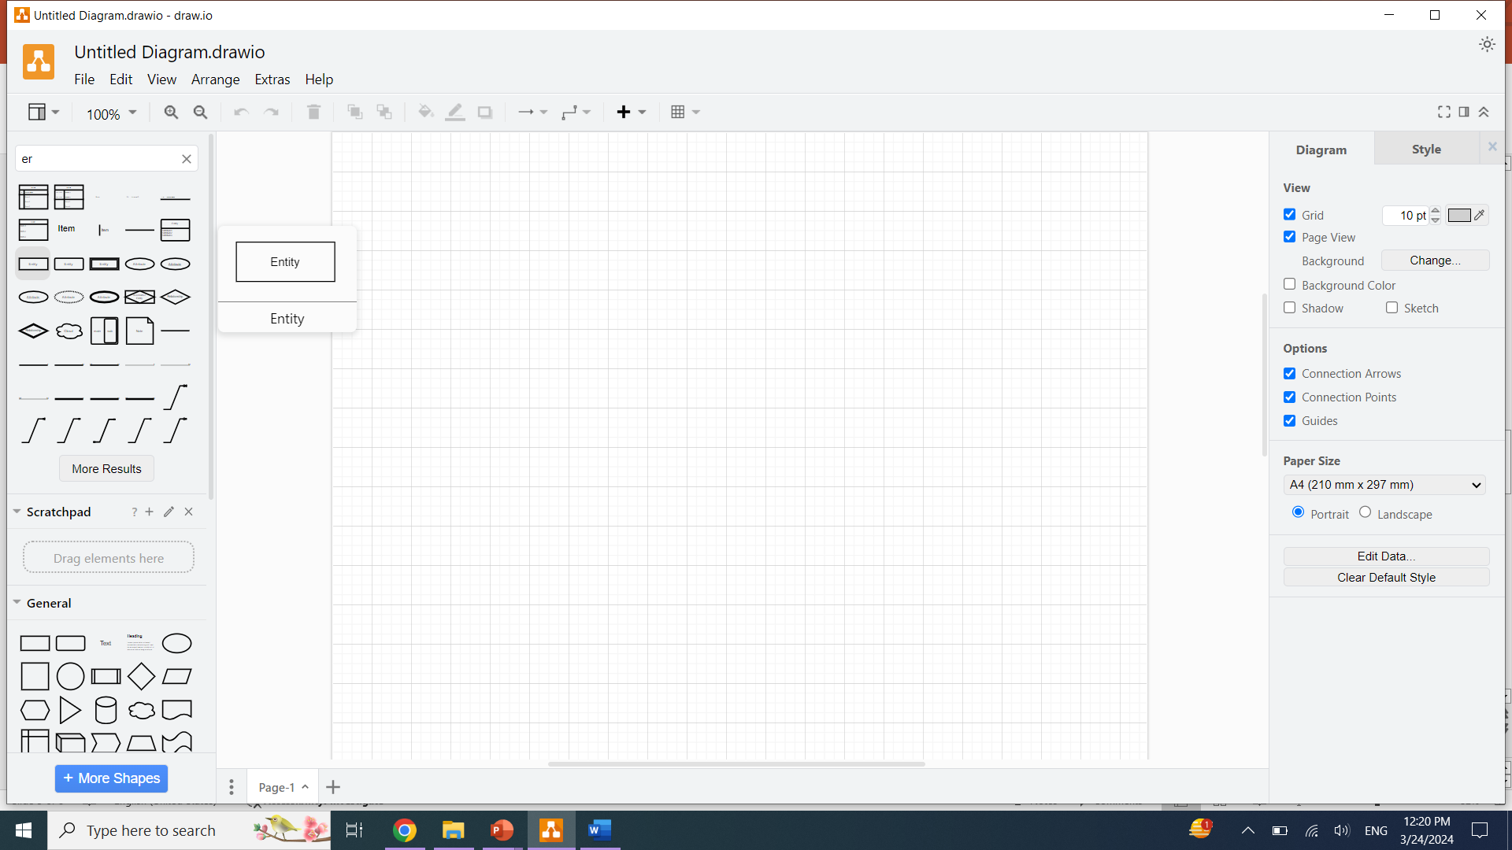
Search ER-Diagram items

Slide 7
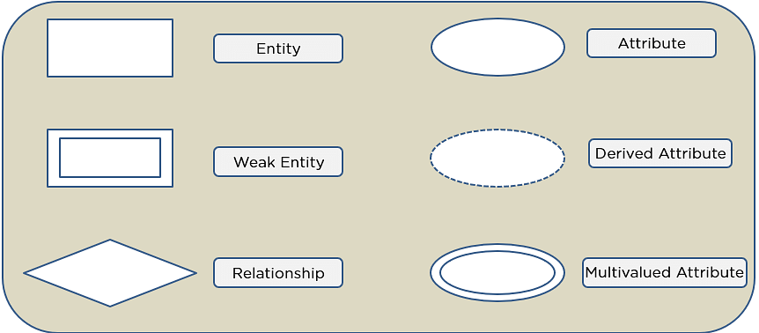
Symbol used in ERD

Slide 8
Important Component of ERD
Entities
Weak Entity
Attributes
Key Attribute
Composite Attribute
Multivalued Attribute
Derived Attribute
Relationships
One-to-One Relationships
One-to-Many Relationships
Many-to-One Relationships
Many-to-Many Relationships

Slide 9

Entities Example
A student study course, both the student and the course are entities

Slide 10

Weak - Entities Example
School is a strong entity because it has a primary key attribute - school number. While, the classroom is a weak entity because it does not have any primary key and the room number here acts only as a discriminator

Slide 11
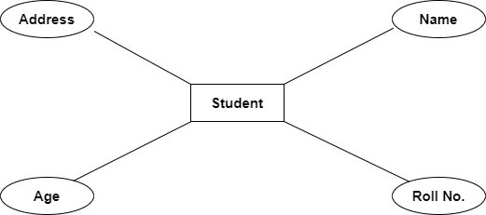
Attribute Example
An attribute exhibits the properties of an entity.

Slide 12
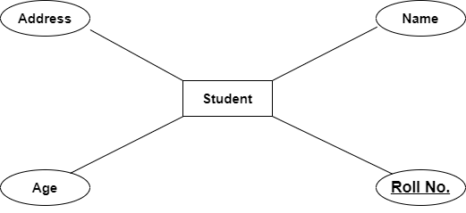
Key - Attribute Example
An attribute exhibits the properties of an entity.

Slide 13
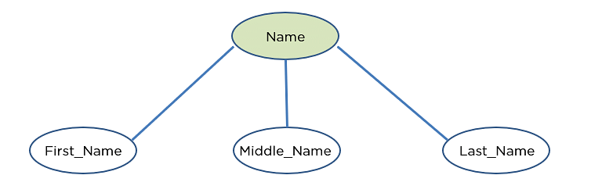
Composite Attribute Example
An attribute that is composed of several other attributes is known as a composite attribute.

Slide 14
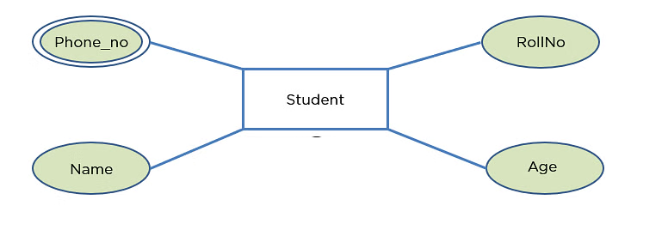
Multivalued Attribute Example
Some attributes can possess over one value, those attributes are called multivalued attributes.

Slide 15
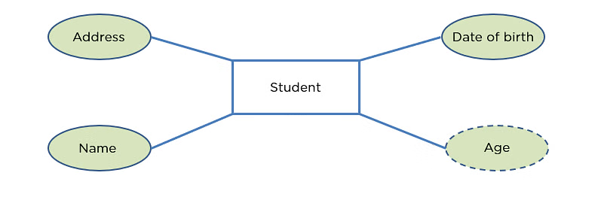
Derived Attribute Example
An attribute that can be derived from other attributes of the entity is known as a derived attribute.

Slide 16
Relationship Example
The student and the course both are entities, and study is the relationship between them

Slide 17

one-to-one Relationship Example
Student has only one identification card and an identification card is given to one person.

Slide 18

one-to-many Relationship Example
Customer can place many orders, but an order cannot be placed by many customers.

Slide 19

many-to-one Relationship Example
A students have to enroll a single course, but a course can have many students.

Slide 20

many-to-many Relationship Example
You can assign an employee to many projects and a project can have many employees.

Slide 21
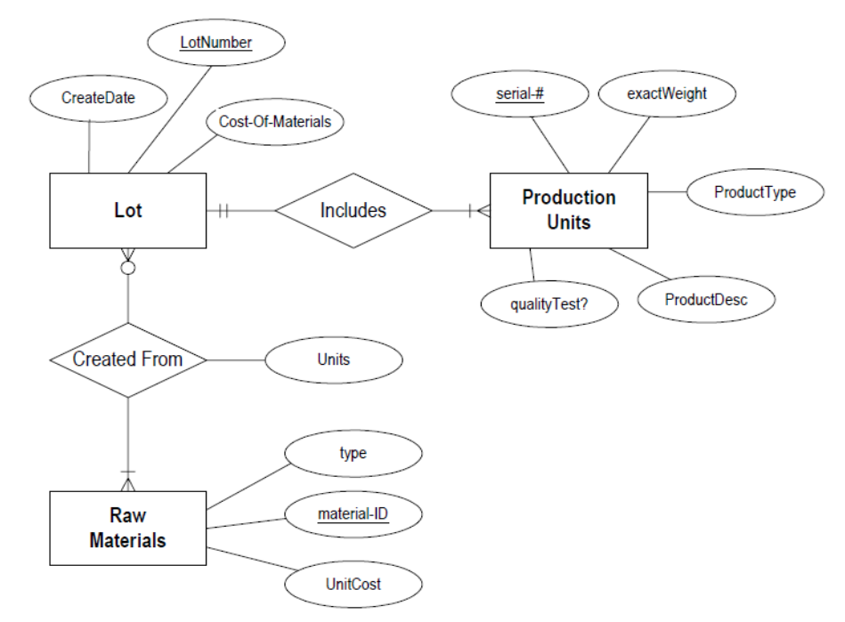
Example to Create ER-Diagram

Slide 22
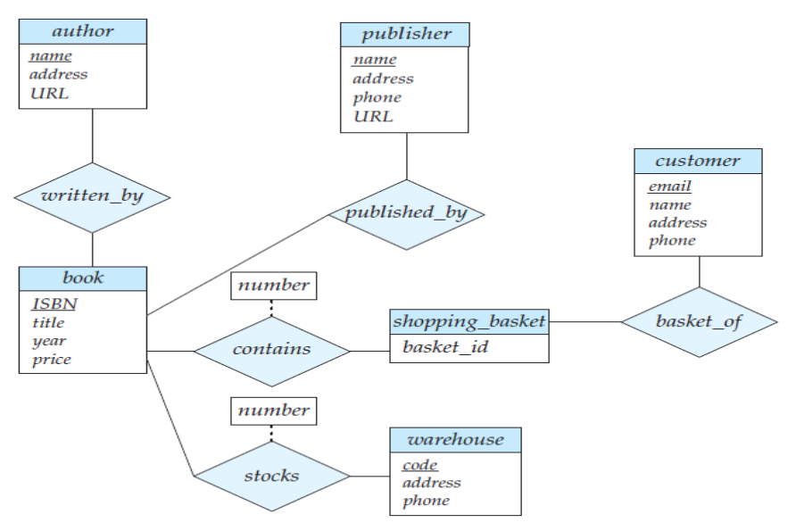
Example to Create ER-Diagram

Slide 23
Task: Student Enrollment
In a university, a Student enrolls in Courses. A student must be assigned to at least one or more Courses. Each course is taught by a single Professor. To maintain instruction quality, a Professor can deliver only one course

Slide 24
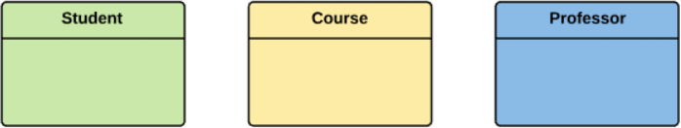
Step 1: Entities Identification
We have three entities
Student
Course
Professor

Slide 25
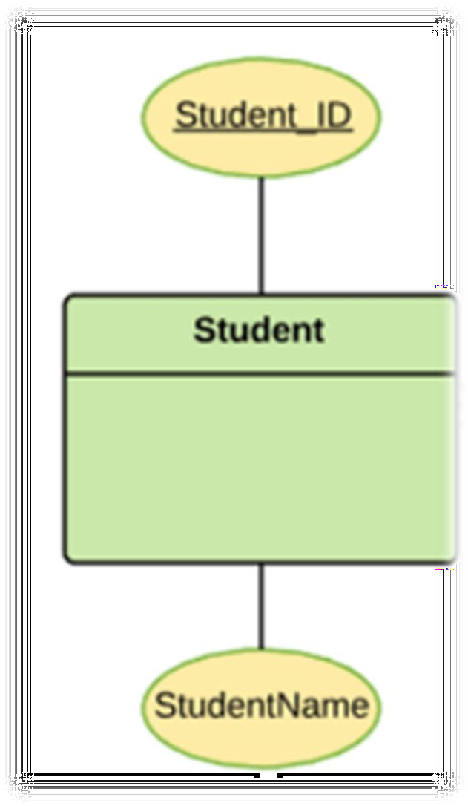
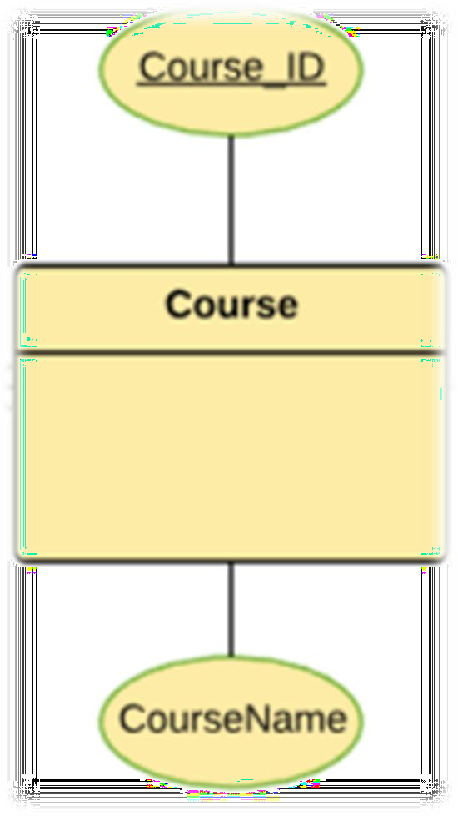
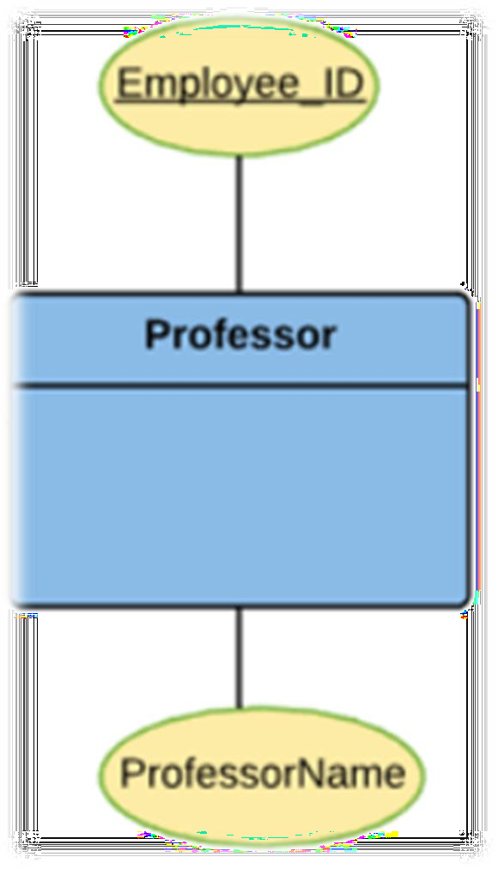
Step 2: Identify Attributes

Slide 26
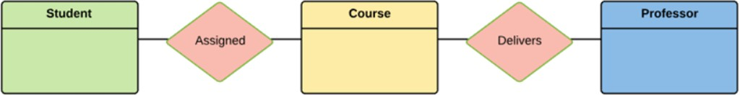
Step 3: Relationship Identification
We have the following two relationships
The student is assigned a course
Professor delivers a course

Slide 27
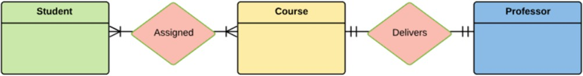
Step 4: Cardinality Identification
For them problem statement we know that,
A student can be assigned multiple courses
A Professor can deliver only one course

Slide 28
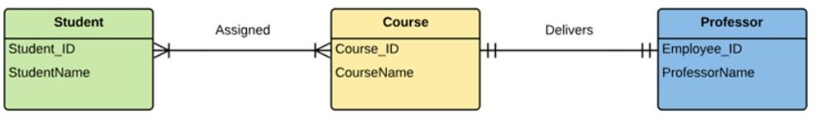
Step 5: Create the ERD Diagram
A more modern representation of Entity Relationship Diagram

